Slide 1


SpaceX Booster Landing Prediction for Competitive Launch Bidding
Daniel Nezich
September 15, 2021

Slide 2

Outline
Executive Summary
Introduction
Business Case
Methodology
Results
Conclusion
Acknowledgements
Appendix

Slide 3
Executive Summary
Data summarizing SpaceX launch history and booster landing outcomes is visualized and used to train supervised learning models
A Support Vector Machine model provides highest prediction accuracy of booster landing outcome (83.3%)

Slide 4
Introduction
Commercial space launch companies are pursuing landing and re-use of first stage boosters (the largest and easiest to recover component in an orbital rocket) in order to decrease equipment cost and rocket construction/qualification lead time. These are two critical measures of efficiency and predictors of profitability in the space launch sector.
In order to make accurate predictions of booster recovery for optimization of launch pricing we want to discover:
What details of the launch are predictive of booster recovery?
With what model can we best predict booster recovery?
With what accuracy can we predict booster recovery?

Slide 5
Business Case
Launch pricing can be tailored to the mission for competitive pricing
Assume all launches are equivalent except for recovery
Let C_{R} be the launch cost with recovery and C_{N} be the launch cost without recovery
The savings due to recovery is D = C_{N} – C_{R}
Let R be the naïve rate of recovery
The average cost per launch is C_{Avg} = C_{N} – RD = C_{R} + (1-R)D
Let pricing be C_{N} if non-recovery is predicted and C_{PR} if recovery is predicted
Assume prediction with accuracy A and worst-case errors (all errors are false recoveries)
Cost penalty due to accuracy must be included in predicted recovery cost: C_{PR} = C_{R} + D(1-A)
The average cost with savings with predictive pricing for recovery is E = C_{Avg} – C_{PR} ≥ (A-R)D
This study determines R = 0.67 and A = 0.83 such that E ≥ 0.16 D
Launch pricing for predicted recovery can be priced below the average launch cost by at least 16% of the recovery savings, which maximizes competitiveness for recovered launches at the cost of full price for predicted nonrecovered launches
The booster comprises ~60% of the launch cost, or ~$37 million [1], so D = 0.60 C_{N}, C_{N} = $62 million
The cost for a predicted recovered launch can be lowered below average by a significant E ≥ 0.10 C_{N} = $6.0 million
The average launch cost for upcoming missions C_{Avg} can be accurately estimated using the booster recovery rate R predicted for a set of upcoming launches
[1] https://www.cnbc.com/2020/04/16/elon-musk-spacex-falcon-9-rocket-over-a-million-dollars-less-to-insure.html

Slide 6


Slide 7
Methodology
Executive Summary
Data collection methodology:
Use the SpaceX REST API and webscraping to collect a list of launches and launch parameters including booster landing outcomes
Perform data wrangling
Missing values were replaced with the average, and only single-core single-payload Falcon 9 launches prior to 2020-11-13 are considered
Perform exploratory data analysis (EDA) using visualization and SQL
Perform interactive visual analytics using Folium and Plotly Dash
Perform predictive analysis using classification models
Use scikit-learn GridSearchCV to tune hyperparameters for Logistic Regression, Support Vector Machine, Decition Tree, and K-Nearest Neighbors models, optimizing for prediction accuracy

Slide 8
Data Collection
Two datasets were collected, using different collection techniques:
Direct requests to the SpaceX REST API
Webscraping a Wikipedia page
Collected data consists of:
A list of rocket flights and relevant flight parameters like date, rocket type, payload mass, etc.
Only single-core, single-payload Falcon 9 launches before mid-November 2020 were retained
Data was sasved in a pandas DataFrame (and to file for reference)

Slide 9
Data Collection – SpaceX API
Used requests to get data from SpaceX REST API endpoints including a list of past launches and launch parameters
https://api.spacexdata.com/v4/
launches/past
rockets/<Rocket ID>
launchpads/<Launchpad ID>
payloads/<Payload ID>
cores/<Core ID>
Responses parsed into a pandas DataFrame (for all variables, see Appendix)
Data Acquisition
SpaceX REST API
Get list of past launches
Extract variables and IDs
Decode IDs to variables
Filtering
Pandas DataFrame
Drop multiple cores/payloads
Drop launces after 2020-11-13
Drop non-Falcon 9 launches
Empty Payload Mass set to mean
https://github.com/Arkadiatri/SpaceX-Prediction/blob/master/SpaceX Data Collection API.ipynb

Slide 10
Data Collection - Scraping
Used requests to download the Wikipedia page List of Falcon 9 and Falcon Heavy Launches
Parsed webpage using BeautifulSoup
Extracted all tables detailing past launches
Extracted cell data with custom functions
Data assembled into a pandas DataFrame (for all variables, see Appendix)
Data Acquisition
Webscraping
Download webpage
Parse with BeautifulSoup
Extract tables
Extract column names
Extract non-header data
Filtering
None
https://github.com/Arkadiatri/SpaceX-Prediction/blob/master/SpaceX Web Scraping.ipynb

Slide 11
Data Wrangling
Data from the SpaceX API was read into a pandas DataFrame and examined
Successful landings were identified and used to create a label column
Successful landing rate is 2/3
Data Wrangling
SpaceX REST API
Import SpaceX API data
Examine nulls and data types
Count:
Landings per site
Target orbits
Landing outcomes
Create landing outcome label
https://github.com/Arkadiatri/SpaceX-Prediction/blob/master/SpaceX Data Wrangling.ipynb

Slide 12
EDA with Data Visualization
Examined categorical plots (seaborn catplot) labeled by landing outcome to visualize trends in data
Payload Mass vs. Flight Number: later flights with less mass are more likely to land
Launch Site vs. Flight Number: sites are preferenced during periods of time causing failure clustering
Launch Site vs. Payload Mass: payload mass differs between sites indicating biased mission profiles
Orbit Type vs. Flight Number: some orbits are biased toward later launch dates (successful landing)
Orbit Type vs. Payload Mass: heavier payloads increase low orbit success and decrease high orbit success
Examined Landing Success Rate vs. Target Orbit: mass affects success differently by orbit
Examined Landing Success Rate vs. Year: increase from 0 in 2013 to ~85% in 2020
Created dummy-encoded feature dataframe using 12 relevant features (see Appendix for list)
https://github.com/Arkadiatri/SpaceX-Prediction/blob/master/SpaceX EDA with Visualization.ipynb

Slide 13
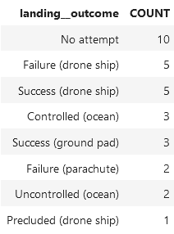
EDA with SQL
Loaded Web Scraping results into an IBM Db2 database
Ran SQL queries to the Db2 database in JupyterLab
Queries demonstrating basic SQL interrogation
E.g. Rank the count of landing outcomes between 2010-06-04 and 2017-03-20 in descending order
Informational only, no results saved to file
https://github.com/Arkadiatri/SpaceX-Prediction/blob/master/SpaceX Exploratory Data Analysis.ipynb

Slide 14
Build an Interactive Map with Folium
Created an interactive map with folium to display launch sites using the following elements:
Circle – For indicating a region of interest (launch sites)
Marker - For placing an item on the map:
DivIcon – For displaying arbitrary text/HTML, such as labels like location name or distance
Icon – For displaying a simple symbol (map pointer with circle of customizable color inside), like landing success coded by color
MarkerCluster – Plugin element for containing other elements (Markers), grouping them together when zoomed out for easy viewing
MousePosition – Plugin element for displaying the mouse coordinates in latitude and longitude, for locating regions of interest
PolyLine – Draws a line between coordinates, e.g. between launch site and region of interest
End result: a map with circles and labels for each launch site, a MarkerCluster containing a Marker for each launch that is color coded to the landing success, lines and labels for the map from a launch site to the nearest railway, ocean, and city labeled with distances in kilometers, and a display for cursor latitude and longitude
https://github.com/Arkadiatri/SpaceX-Prediction/blob/master/SpaceX Interactive Visual Analytics.ipynb

Slide 15
Build a Dashboard with Plotly Dash
An interactive dashboard with the following elements was made in Plotly Dash:
Dropdown menu for selecting launch site for which to display data in the pie and scatter charts
Pie chart of landing successes by launch site, or landing outcomes if one launch site is selected
Range slider to select payload mass range for which to display data in the scatter chart
Scatter chart of landing outcomes vs. payload mass by booster version
Text for landing success rates and counts for all selected payload masses and breakdowns by booster versions
These plots allow fast and intuitive exploration of the data and relations among variables
https://github.com/Arkadiatri/SpaceX-Prediction/blob/master/spacex_dash_app.py

Slide 16
Predictive Analysis (Classification)
Load Data
Use features from EDA With Data Visualization section and class labels from Data Wrangling section, split into train and test sets (80-20 split)
Run GridSearchCV using the training set and various estimators (logistic regression, support vector machine, decision tree, k-nearest neighbors) with appropriate hyperparameter grids
Using tuned estimators with the highest training accuracy, compute the accuracy and plot the confusion matrix for the test set
Select the tuned estimator with the highest test set accuracy as the final model
Standardize Data*
Split Train and Test Sets
GridSearchCV
K Nearest Neighbors
Set hyperparameter grid, estimator
Decision Tree
Support Vector Machine
Logistic Regression
Fit and predict
Score accuracy
Plot confusion matrix
Select most accurate model
https://github.com/Arkadiatri/SpaceX-Prediction/blob/master/SpaceX Machine Learning Prediction.ipynb
* Standardization should properly be done after test/train splitting

Slide 17
Results
Exploratory data analysis results
Interactive analytics demo in screenshots
Predictive analysis results

Slide 18


Slide 19
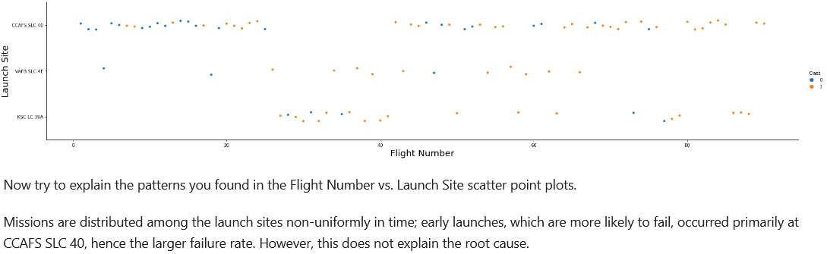
Flight Number vs. Launch Site

Slide 20
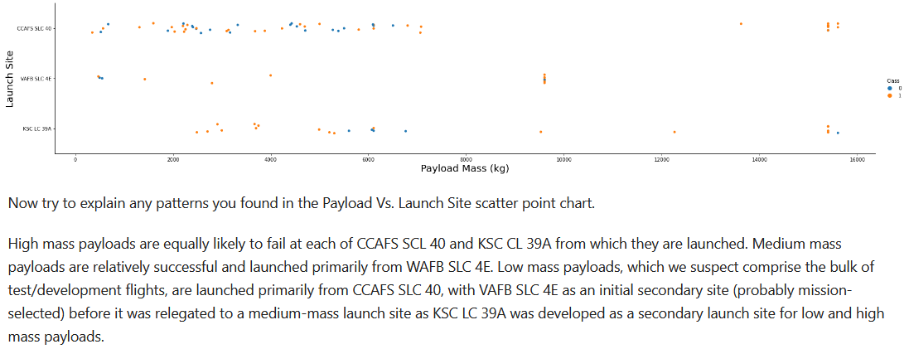
Payload vs. Launch Site

Slide 21
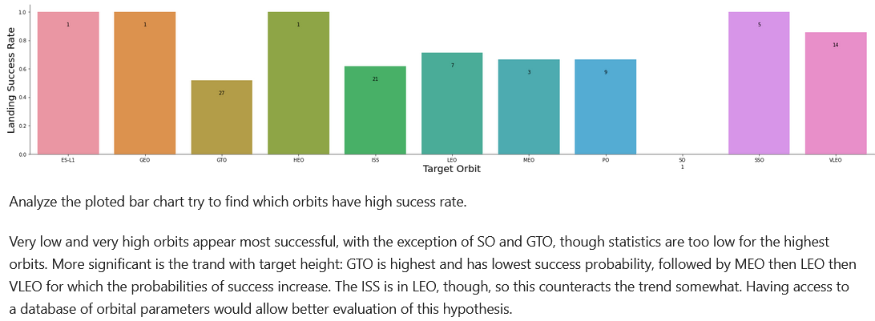
Success Rate vs. Orbit Type
Numbers on bars indicate support

Slide 22
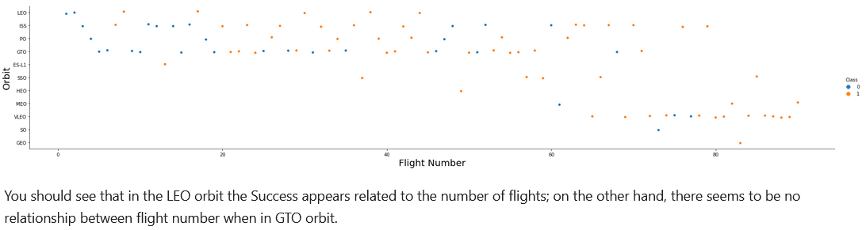
Flight Number vs. Orbit Type

Slide 23
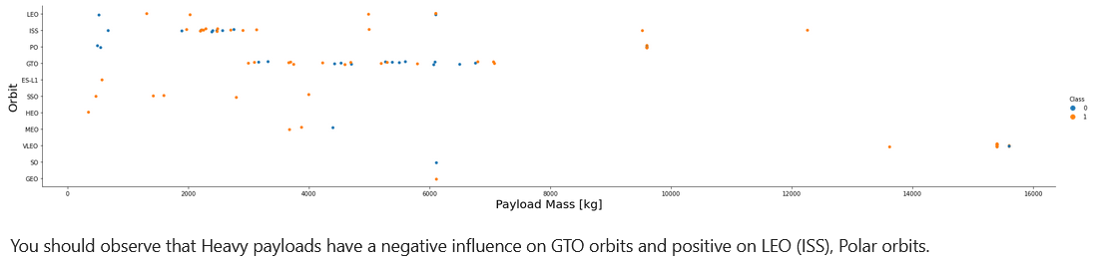
Payload vs. Orbit Type

Slide 24
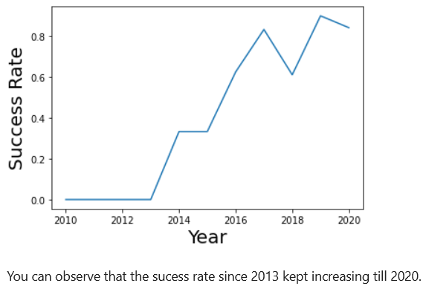
Launch Success Yearly Trend

Slide 25
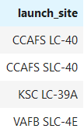
All Launch Site Names
There are four unique launch site names

Slide 26
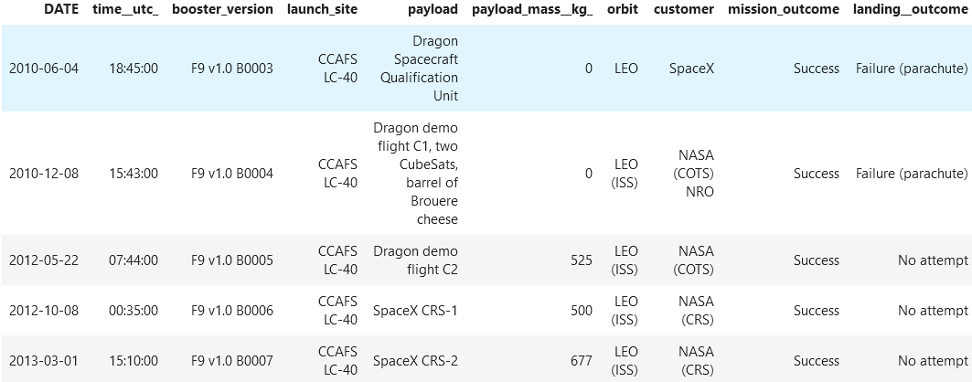
Launch Site Names Begin with 'CCA'
We can retrieve only entries for launches at Cape Canaveral Air Force Station (now Space Force Station)

Slide 27
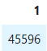
Total Payload Mass
SpaceX has launched over 45 metric tons to the ISS for NASA

Slide 28
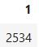
Average Payload Mass by F9 v1.1
The average Falcon 9 v1.1 launch carries 2.5 metric tons to orbit

Slide 29
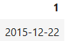
First Successful Ground Landing Date
The first successful ground landing of a booster was on December 22nd, 2015

Slide 30
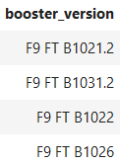
Successful Drone Ship Landing with Payload between 4000 and 6000
Four boosters have successfully landed on a drone ship after carrying a 4-6 metric ton payload

Slide 31
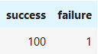
Total Number of Successful and Failure Mission Outcomes
Falcon 9 boosters have a high mission success rate of 99%

Slide 32
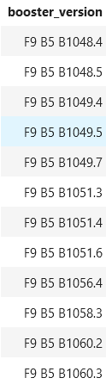
Boosters Carried Maximum Payload
Six boosters have carried the maximum payload on a total of 12 launches

Slide 33
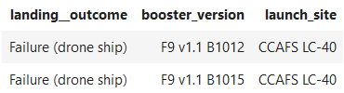
2015 Failed Drone Ship Landings
There were only two failed drone ship landings in 2015

Slide 34
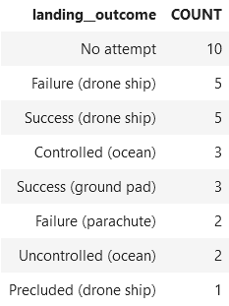
Rank Landing Outcomes Between 2010-06-04 and 2017-03-20
The most frequent landing outcome was no attempt (likely due to mission parameters), and drone ship landing were 50% successful in this time period

Slide 35


Slide 36
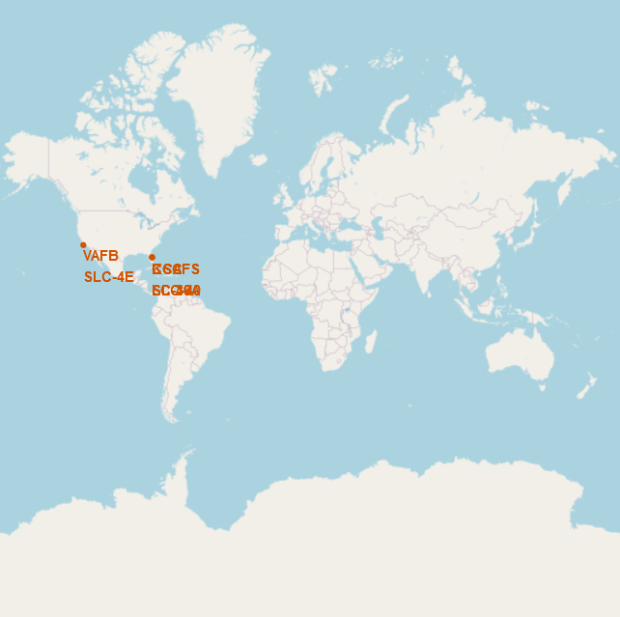
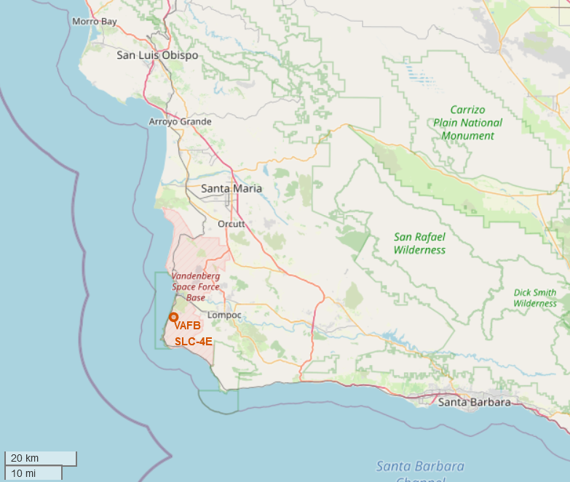
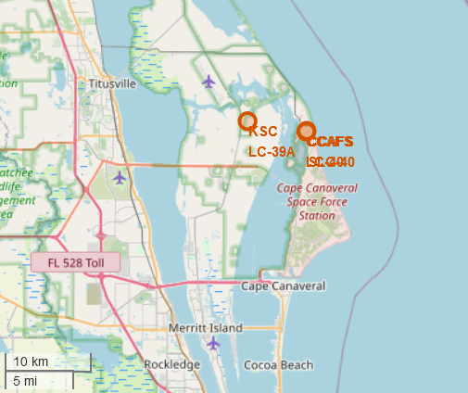
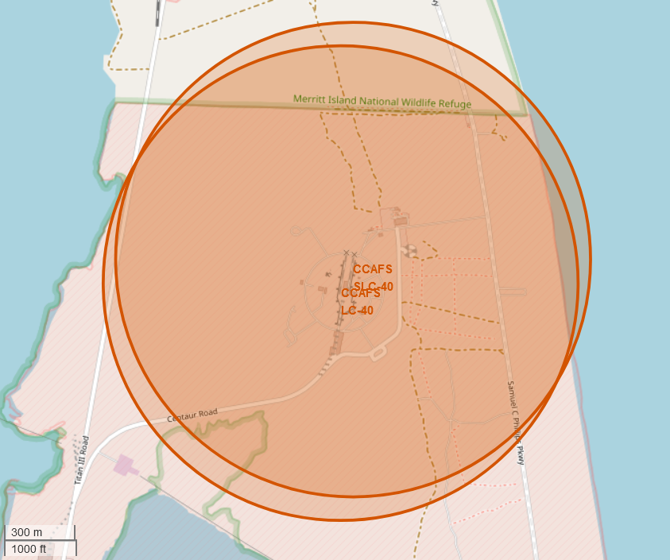
Launch Site Locations
There are four launch sites total close to the equator on either coast of the continental United States; one in California and three in Cape Canaveral, Florida

Slide 37
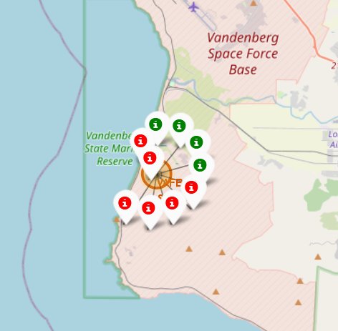
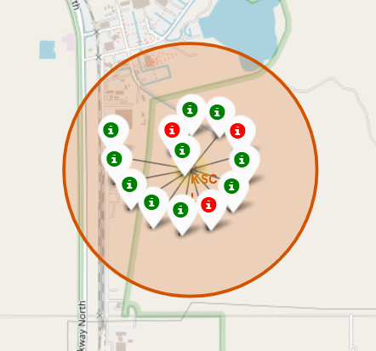
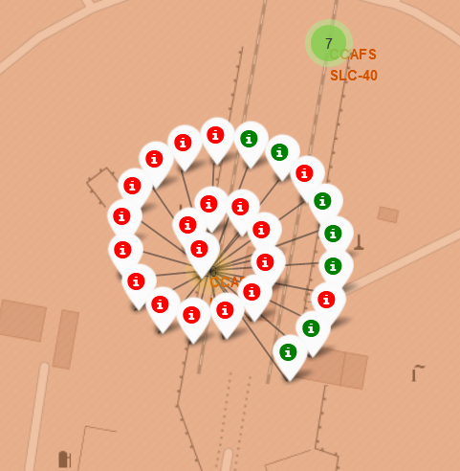
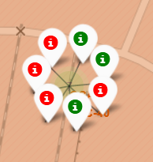
Landing Outcome Visualization
One marker per launch, green (red) is an (un)successful booseter landing
Highest booster recovery rate at KSC LC-39A, lowest at CCAFS LC-40
VAFB SLC-4E
KSC LC-39A
CCAFS LC-40
CCAFS SLC-40

Slide 38
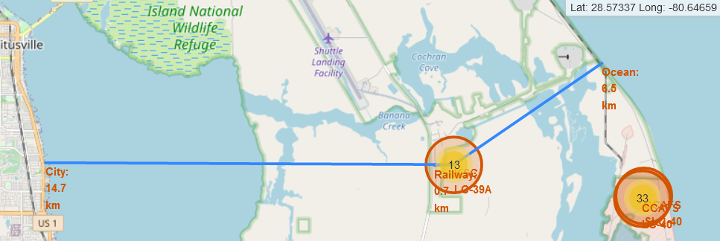
Launch Site Proximities
Proximal features for KSC LC-39A:
Railroad 0.7 km, Ocean 6.5 km, City 14.7 km

Slide 39


Slide 40
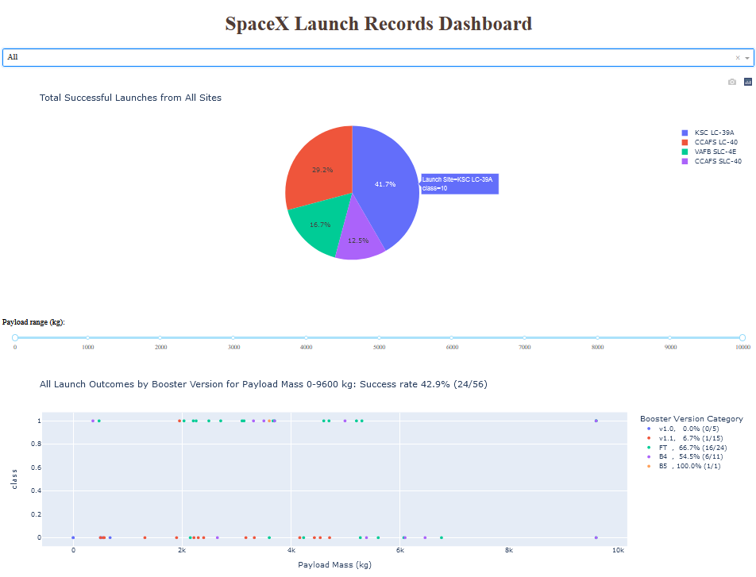
Dashboard – All Launch Sites
KSC LC-39A has the highest number of successful booster recoveries (10, highlighted)
FT (v1.2) boosters have the highest successful landing rate (66.7%) of versions with more than one launch (B5 has 100% successful landings, but only one launch)
Dropdown menu – select launch site
Pie chart –
Successful recoveries
by launch site
or
Recovery outcome
for chosen launch site
Added success counter
Range slider - payload mass selection
Added percent and success/total counts for all selected launches
Added percent and success/total counts for each booster version
Scatter plot - recovery outcome (1=success, 0=failure) for selected launch site and payload mass, colored by booster version

Slide 41
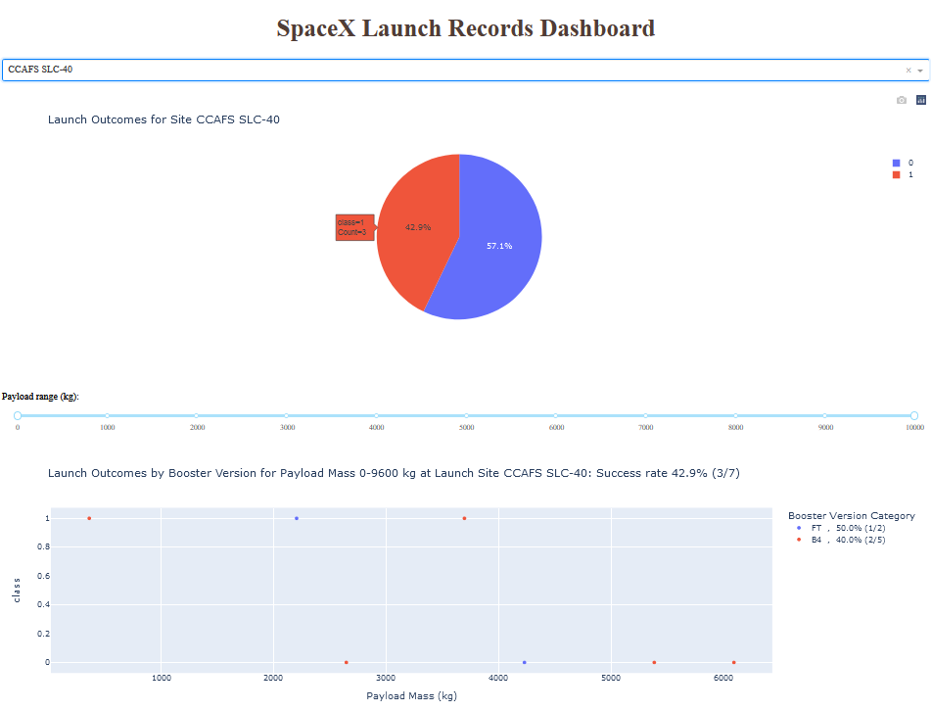
Dashboard – Most Successful Launch Site
Selected single launch site
Site CCAFS SLC-40 has the highest landing success rate (42.9%, 3 successes of 7 launches)
Site landing success (red) and failure(blue) pie chart
All payload masses selected
Site launch success rate and supports

Slide 42
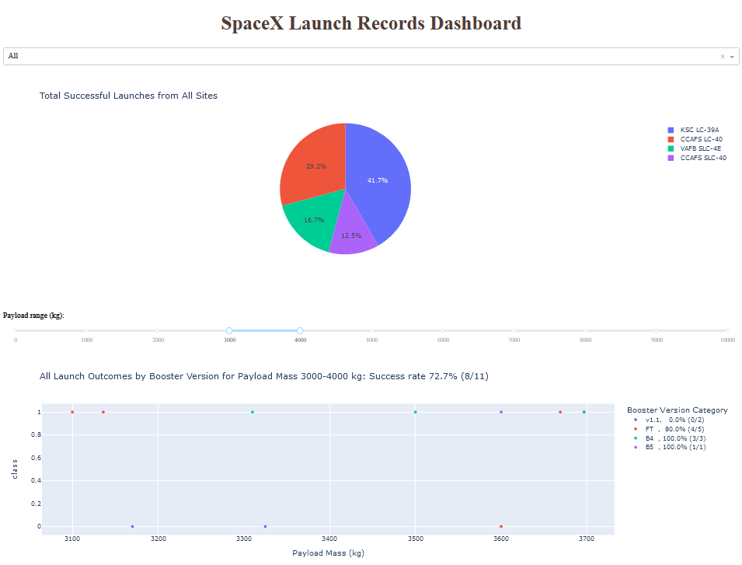
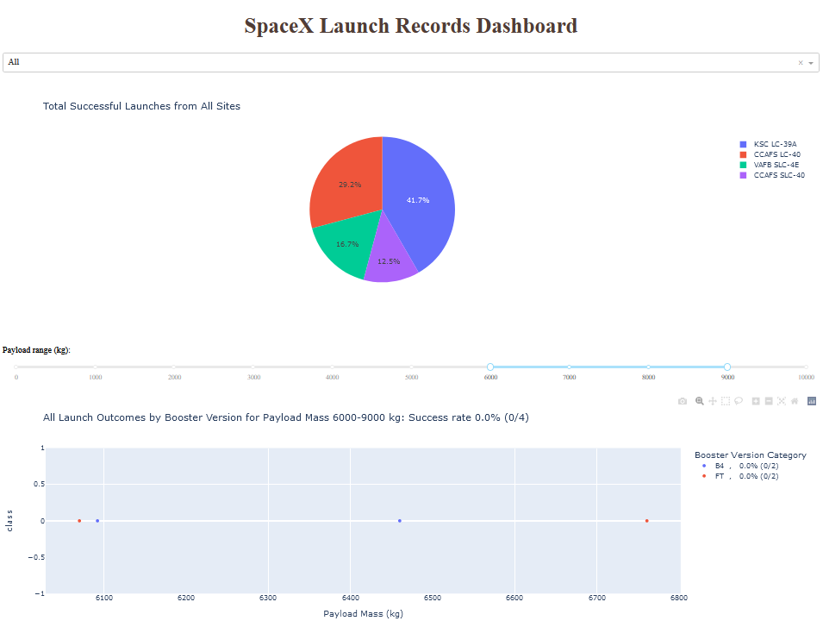
Dashboard – Payload Mass Effect
Highest: 72.7% for Payload Mass 3-4 tons
Among all sites, in payload mass ranges of 1 metric ton, 3-4 ton payloads have the highest landing success rate and 6-9 ton payloads have the lowest landing success rate
Note there are no launches in the 7-9 ton payload mass window
These results can be seen by visually windowing the All Launch Sites scatter plot, but using the slider computes the actual success/total counts and success rate
Lowest: 0% for Payload Mass 6-9 tons

Slide 43


Slide 44
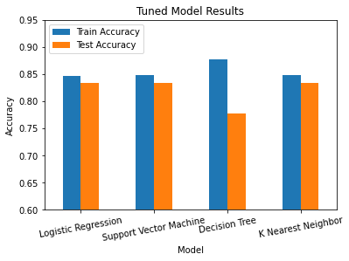
Classification Accuracy
Surprisingly, three models have the same test accuracy and are equally optimal estimators:
Logistic Regression
Support Vector Machine
K Nearest Neighbor

Slide 45
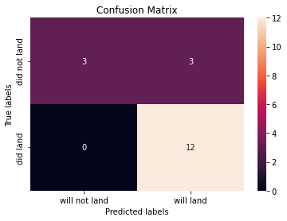
Confusion Matrix
All three identically predictive models have the same confusion matrix
False positive predictions are the primary error

Slide 46
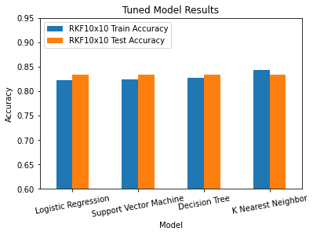
Extension – Repeated K-Fold Cross-Validation
Taking the best models from 10 repeats of the previous 10-fold cross-validation approach results in identical test accuracy for all estimators
Confusion matrix for all models is now identical (as shown previously)

Slide 47
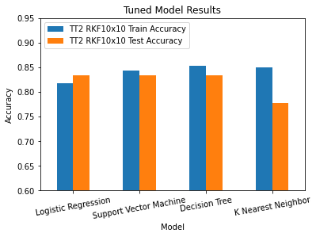
Extension – Alternate Train/Test Split
An alternate train/test split randomization leads to different fitting results
Confusion matrices are altered in distribution of errors among false positives and false negatives

Slide 48
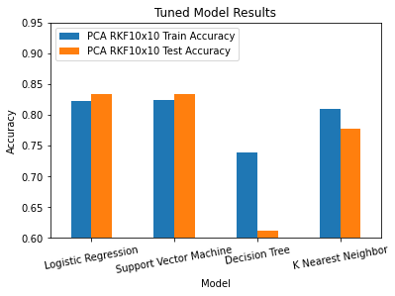
Extension – Feature Importance by PCA (83)
Principal Component Analysis with all 83 components produces very similar results, with no improvement in maximum test accuracy
Decision Tree performance is degraded since information is clustered in fewer features and overfitting is likely to low-information features

Slide 49
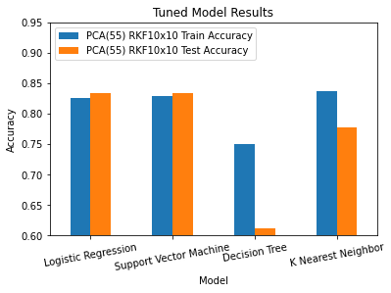
Extension – Feature Importance by PCA (55)
Principal Component Analysis with top 55 retained components produces very similar results, with no improvement in maximum test accuracy
K Nearest Neighbor model now suffers an accuracy decrease in addition to Decision Tree

Slide 50
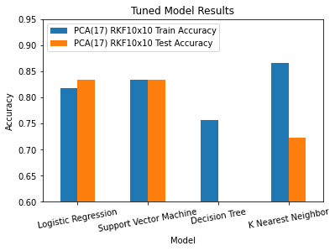
Extension – Feature Importance by PCA (17)
Principal Component Analysis with top 17 components produces very similar results, with no improvement in maximum test accuracy
K Nearest Neighbor model now suffers an accuracy decrease
Curiously, Decision Tree performs even worse
(55.6%)

Slide 51
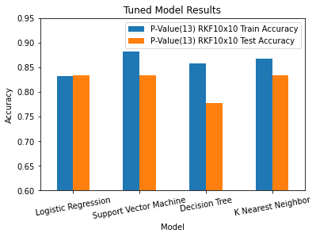
Extension – Feature Importance by P-Value (13)
Restricting features to those with p-values above 0.05 (13 total) produces improved training accuracy, with no improvement in maximum test accuracy
Decision Tree performs worse compared to the repeated k-fold cross-validation seen previously

Slide 52
Conclusions
A support vector machine is the recommended booster recovery prediction model
Consistently achieves highest test accuracy, supported by highest train accuracy
A logistic regression model is a test accuracy peer with lower train accuracy but faster training
Booster recovery can be predicted with 83.3% accuracy
Errors are primarily false positives
Improvement over:
Random guessing 50%
Always predict majority class (recovery) 66.7%
SpaceX can reduce predicted recovery launch prices by 16% of the recovery savings below the average launch cost in order to provide an extremely competitive bid

Slide 53
Acknowledgements
Contributors to StackOverflow and forums for python libraries used in this project
IBM Data Science Professional Certificate Coursera course contributors
Primary Instructors: Joseph Santarcangelo, Yan Luo
Other Contributors & Staff
Project Lead: Rav Ahuja
Instructional Designer: Lakshmi Holla
Lab Authors: Joseph Santarcangelo, Yan Luo, Azim Hirjani, Lakshmi Holla
Technical Advisor: Yan Luo
Production Team
Publishing: Grace Barker, Rachael Jones
Project Coordinators: Kathleen Bergner
Narration: Bella West
Video Production: Simer Preet, Lauren Hall, Hunter Bay, Tanya Singh, Om Singh
Teaching Assistants and Forum Moderators
Malika Singla
Duvvana Mrutyunjaya Naidu

Slide 54
Appendix
Data Collection – SpaceX REST API:
https://api.spacexdata.com/v4/launches/past for Flight Number, Date, Core, Rocket ID, Payload ID, Launch Pad ID
Core dict extracted to obtain: Core ID, Outcome, Flights, Grid Fins, Reused, Legs, Landing Pad
https://api.spacexdata.com/v4/rockets/ for Rocket ID to Booser Version
https://api.spacexdata.com/v4/launchpads/ for Launch Pad ID to Latitude, Longitude, Launch Site
https://api.spacexdata.com/v4/payloads/ for Payload ID to Payload Mass, Orbit
https://api.spacexdata.com/v4/cores/ for Core ID to Block, Reused Count, Serial
Saved to dataset_part_1.csv
Data Collection – Web Scraping:
https://en.wikipedia.org/w/index.php?title=List_of_Falcon_9_and_Falcon_Heavy_launches&oldid=1027686922
Parsed to obtain: Flight Number, Launch Site, Payload, Payload Mass, Orbit, Customer, Launch Outcome, Booser Version, Booster Landing, Date, Time
Saved to spacex_web_scraped.csv

Slide 55
Appendix
Data Wrangling
Begin from dataset_part_1.csv
Check missing values and data types
Count number of launches at each site
Count number or each orbit types
Count number of landing outcomes 'Outcome' col
Create list of bad outcomes (lead value in Outcome is False or None)
Create label column 'Class'
2/3 successful return rate
Save results to file dataset_part_2.csv

Slide 56
Appendix
EDA With Visualization (Plots)
Started with dataset_part_2.csv
Features selected: FlightNumber, PayloadMass, Orbit, LaunchSite, Flights, GridFins, Reused, Legs, LandingPad, Block, ReusedCount, Serial
Dummy-encoded features: Orbit, LaunchSite, LandingPad, Serial
All features cast as Float
Save results to dataset_part_3.csv

Slide 57
Appendix
Exploratory Data Analysis (SQL)
Begin from Spacex.csv (similar to SpaceX API dataset, but with more entries and some typos)
Upload data file to IBM Db2 SQL server
Connect to Db2 server through JupyterLab using ibm_db_sa, ipython-sql, and sqlalchemy
Run SQL queries to identify:
Unique launch sites
5 records where the launch site begins with 'CCA'
Total payload mass with customer 'NASA (CRS)
Average payload mass carried by booser version F9 v1.1
Date of first successful booster landing on a ground pad
Names of boosters with successful drone ship landing and payload mass between 4000 and 6000 kg
Total number of successful and failure mission outcomes
Booster versions that have carried the maximum payload
List failed drone ship landings with booster version, launch site, and landing outcome in 2015
Rank the count of landing outcomes between 2010-06-04 and 2017-03-20 in descending order

Slide 58
Appendix
Interactive Visual Analytics (Folium)
Begin from spacex_launch_geo.csv (apparently a variant of the SpaceX API data)
Analyze a subset of the data – launch site, latitude, longitude, and class
Circle – For indicating a region of interest
Marker - For placing an item on the map
DivIcon – For displaying arbitrary text/HTML, displayed by the Marker
Icon – For displaying a simple symbol (map pointer with circle of customizable color inside)
MarkerCluster – Plugin element for containing other elements (Markers), grouping them together when zoomed out
MousePosition – Plugin element for displaying the mouse coordinates in latitude and longitude
PolyLine – Draws a line between coordinates
Calculate distance from latitude and longitude with an explicit spherical approximation
Map with circles and labels for each launch site, a MarkerCluster containing a Marker for each launch that is color coded to the landing success, lines and labels for the map from launch site to the nearest railway, ocean, and city with distances in kilometers
Launch sites are in close proximity to railways (<1.5 km) due to railways being one of the most reasonable ways to transport large and heavy rocket components.
Launch sites are in close proximity to highways (<1.5 km) due to the need to transport personnel and light equipment to the launch site.
Launch sites are in close proximity to coastline to increase the nearby fraction of disaster-amenable surface area e.g. areas that will not catch fire or be caused damage by debris from an explosion post-liftoff.
Launch sites seem to keep at least 10 km away from cities (the closest approach to a notable city is VAFB SLC-4E to the city of Lompoc), to minimize risk of casualties in case of an accident at the launch complex or in the early rocket flight.

Slide 59
Appendix
Dashboard
Variables:
Date
Time (UTC)
Booster_Version
Launch_Site
Payload
PAYLOAD_MASS__KG_
Orbit
Customer
Mission_Outcome
Landing _Outcome

Slide 60
Appendix
Presentation improvements beyond the template
Included a Business Case slide
Considered launch statistics support in Dashboard slides
Expanded Appendix
Innovative insights
Business Case addition
Quantified competitive edge in pricing: worst-case 10% price reduction (below average cost for predicted recovery while not exceeding total cost for predicted non-recovery) or accurate prediction of upcoming launch costs
Dashboard
Launch probabilities and support displayed for all selected launches and for each booster version
Machine Learning section extensions
Repeated k-fold cross-validation improves model training results
Principal Component Analysis for features makes Decision Tree and K Nearest Neighbor models perform worse
ANOVA p-values can be used to downselect features for models while maintaining performance
Feature preparation should be revisited to correct errant one-hot encoding and create continuous serial number and orbit variables

Slide 61


